Slide 1
CoPilot Safe Assist
Software Engineering 2: Project Teamwork Mälardalens University
Optimus Octavian
Steering Group Meeting Nr.7
Notes:
1

Slide 2
Last week
Notes:
1

Slide 3
Last week’s plan
Form focus groups √
App refactoring/redesign √
Web interface ≈√
Deploy to CoPilot √
Notes:
1
Nessecary for efficient work

Slide 4
Monday Meeting
Forming focus groups: Handheld, CoPilot and Web
Conducted app functionality test
Notes:
2

Slide 5
Group skype meeting
Decided on members presenting on steering meeting
Discussed on the focus groups work progress
Decided on members presenting on the Client Presentation (wednesday)
Planned final meeting for 2017
Notes:
1

Slide 6
CoPilot
Compile and communicate with CoPilot
Deploy and sign apps to work in simulator (and other CoPilots)
Created app that automatically identifies the device
Meeting with MDH contact, Adnan
More insight in how to use and run the simulator
Notes:
2

Slide 7
SafeAssist App
Implemented ”foreground service”
Refactoring
Revised the design and the class diagram
Revised the user interface
Added new features
Dynamic update interval
Home button (needed in CoPilot)
Notes:
1

Slide 8
Web
Minor GUI changes
Finished the main features for both administrator and manager
Problems with connection to the database (solved this morning!)
Notes:
2

Slide 9
Worked hours
Members | Worked Hours this week | Total of Worked Hours
Alvaro | 19 | 68
Dara | 23 | 96
Fernando | 17.5 | 100
Jonas | 12 | 92
Pablo | 24 | 94
Rickard | 22 | 136
Sidorela | 26 | 124
Vasja | 15.5 (absence) | 86
Notes:
1

Slide 10
This week
Notes:
2

Slide 11
This week’s plan
Test CoPilot test-app in simulator
Testing of the SafeAssist app
Fine tune parameters in the SafeAssist app
Wednesday Presentation with Client!
Final meeting and Christmas break work plan
Notes:
2

Slide 12
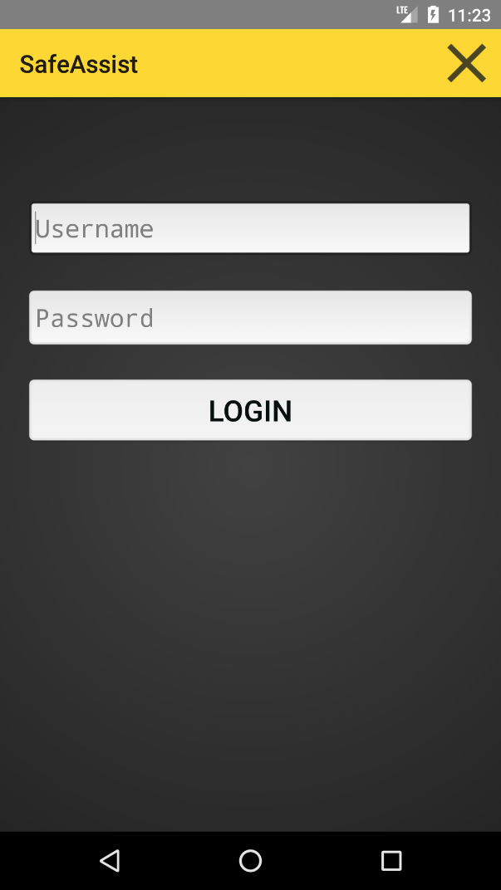
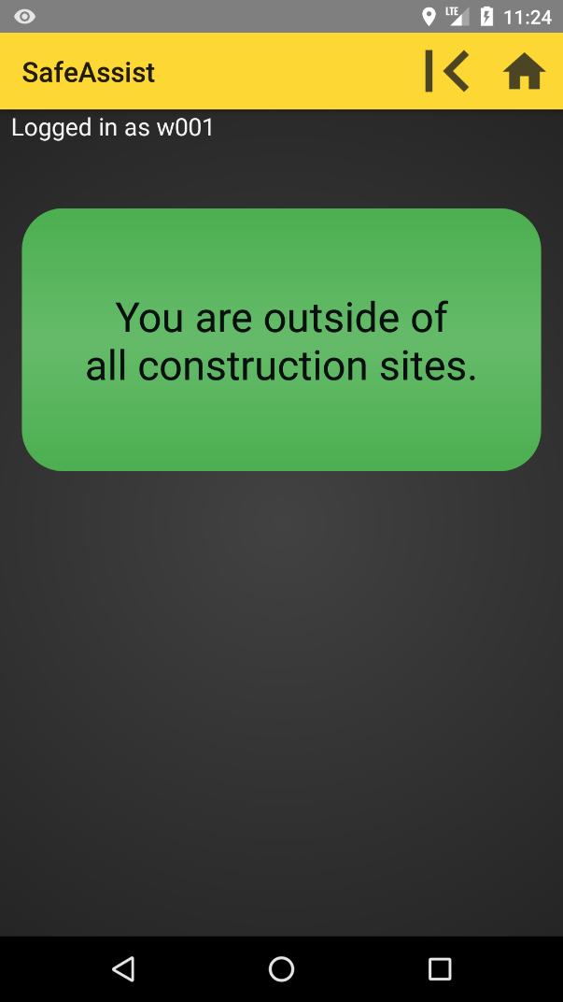
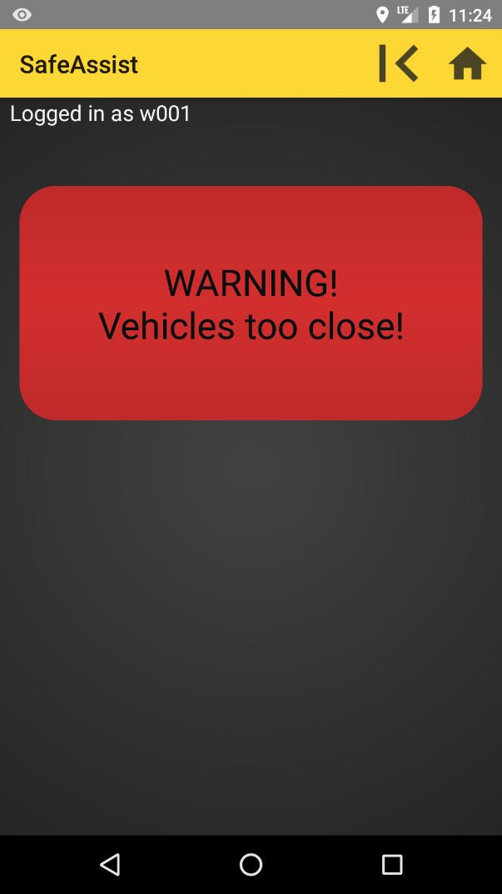
Current app interface
Notes:
1

Slide 13
Thank you!!
Notes:
1

